Slide 1
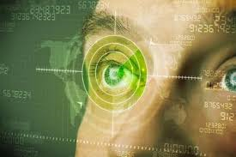
Using Artificial Intelligence for Analyzing the Retinal Images (OCT) in People with Diabetes
Tahani A. Daghistani

Slide 2
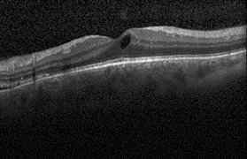
Introduction
Diabetic macular edema (DME) is a common disease of diabetic retinopathy.
Due to the infection of DME disease, many patients’ vision is lost.
To cure DME eye disease, early detection and treatment are very important and vital steps.
Medical imaging developed rapidly to play a central role in medicine today by supporting diagnosis and treatment of a disease.
To automatically diagnosis DEM disease, strategies involving Artificial Intelligence (AI) could provide a solution.

Slide 3
Goal
The main goal of this project is develop an Artificial Intelligence solution that can help to classify OCT.
To achieve our goal, Deep-Learning (DL) model will be used to predict the risk of patients with diabetes developing diabetic retinopathy.
The outcomes would improve patient access to treatment and ease pressures on time and resources in ophthalmology clinics.

Slide 4
Data
The dataset downloaded from the Kaggle website.
A total of (3,500) OCT images included in this dataset.
The ratio of splitting the original dataset (3,500 images) is 50/20/30.
Training data made up of 50% training (1,960 images)
Devote 20% to the validation set (490 images) to provide an unbiased evaluation of a model fit on the training dataset while tuning model hyperparameters
Test dataset made up of remaining 30% (1,050 images) to evaluate the accuracy of the model on the data it has never seen.

Slide 5
Feature Engineering
Resize image to establish a base size for all images fed into our machine learning algorithms.
Classic augmentation techniques like flips and rotations will applied to each image in the training set without manually processing each image.
Shifting, Flipping, Rotating

Slide 6
Models
Classification is the most widely used technique for machine learning.
CNN is a powerful neural network that uses filters to extract features from images.
All popular frameworks support Convolutional Neural Networks like Tensorflow-Keras.
Five models with different Convolutional layers built then the best one selected based on evaluation metrics.

Slide 7
Models
Each input image will pass it through a series of convolution layers with filters (Kernals), Pooling, fully connected layers and apply activation functions to classify an object with probabilistic values between 0 and 1.
Pool feature map applied then flatten our pooled feature map into one-dimensional to be ready for Dense layers.
An epoch is how many times the model trains on our whole data set.
Batch can be explained as taking in small amounts, train and take some more.
Each epoch must finish all batch before moving to the next epoch.
Early Stopping used to reduce the computer calculation, program running time and avoid overfitting.
The model at the time that training is stopped to have good generalization performance.
Model Consists of input layers, two hidden layers, and one output layer

Slide 8
Model Evaluation and Selection
Confusion Matrix
True Positive =True Positive/(True Positive+False Negative)
False Positive (FPR)=False Positive/(False Positive+True Negative)
Precision=True Positive/(True Positive+False Positive)
Recall=True Positive/(True Positive+False Negative)
F-measure: F_score =2*(precision*recall)/(precision+recall)
Area Under the ROC curve (AUROC)
Loss to evaluate and diagnose model optimization.

Slide 9






Tools
The Jupyter Notebook
Python programming language
Libraries: A library is a collection of pre-combined codes that can be used iteratively to reduce the time required to code.
Tensorflow-Keras for developing deep learning models.
Numpy and pandas for data manipulation
Matplotlib and seaborn for visualization

Slide 10
Results
Table1: The Performance of the Models on the Test Dataset
CNN Model/Metrics | Accuracy | precision | recall | f1-score | AUC
5-Convolutional Layer | 0.82 | 0.82 | 0.82 | 0.81 | 0.82
4-Convolutional Layer | 0.79 | 0.79 | 0.79 | 0.79 | 0.79
3-Convolutional Layer | 0.74 | 0.75 | 0.74 | 0.74 | 0.75
2-Convolutional Layer | 0.74 | 0.74 | 0.74 | 0.74 | 0.74
1-Convolutional Layer | 0.63 | 0.70 | 0.63 | 0.60 | 0.63
Table1: The Performance of the Models on the Test Dataset
CNN Model/Metrics | Accuracy | precision | recall | f1-score | AUC
5-Convolutional Layer | 0.82 | 0.82 | 0.82 | 0.81 | 0.82
4-Convolutional Layer | 0.79 | 0.79 | 0.79 | 0.79 | 0.79
3-Convolutional Layer | 0.74 | 0.75 | 0.74 | 0.74 | 0.75
2-Convolutional Layer | 0.74 | 0.74 | 0.74 | 0.74 | 0.74
1-Convolutional Layer | 0.63 | 0.70 | 0.63 | 0.60 | 0.63
Table2: precision and recall of the Models on the Test Dataset
CNN Model/Metrics | precision | recall
DME | 0.87 | 0.74
Normal | 0.77 | 0.89

Slide 11
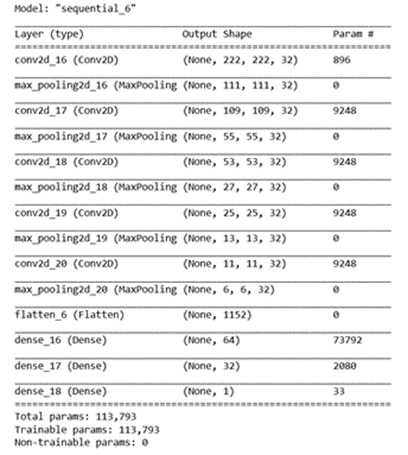
Results
Summary of 5-Convolutional Layer (CNN) Model

Slide 12
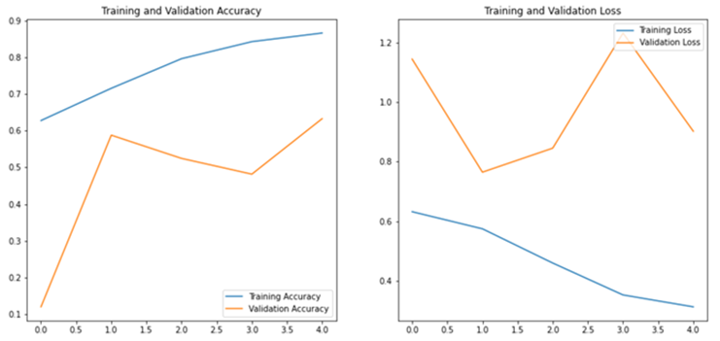
Results
Accuracy and loss for training and validation sets

Slide 13
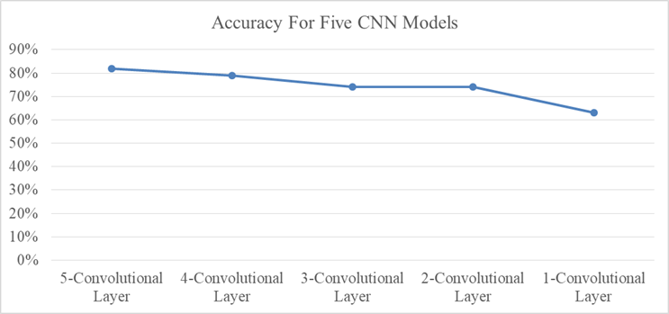
Results
Accuracy achieved for five CNN models

Slide 14
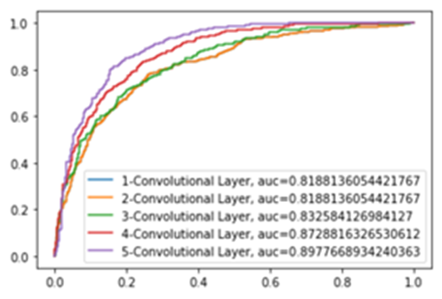
Results
AUC achieved for five CNN models

Slide 15
Conclusion
We propose a deep learning based method to solve the and classification problem in OCT images.
Results show that the proposed method has been successful in predicting the presence of DME in OCT images.

Slide 16
Thank you

